Slide 1

Team 1: Data Quality

Slide 2



The project aim
Create an open, standard and general way to measure the quality of data from all variables used in the eICU database.
GROUP 1: DATA QUALITY
CRITICAL CARE DATATHON - TARRAGONA 2018

Slide 3


What we have found…
GROUP 1: DATA QUALITY
CRITICAL CARE DATATHON - TARRAGONA 2018

Slide 4


Results
Outputs for each table:
Number of cases: Total number of records in each table.
Missing Values (%): of values that have missing values.
Irregular Values (%): of global outliers for the whole table.
Data Case ratio: Relationship between the total numbers of records stored for each case.
Overall Cases (%): The number of cases on each table related to total number of cases in the whole database.
Outliers mean : Arithmetic Average of outliers
Additional table showing an outlier ratio: percentage of outliers for each variable contained in each table in the eICU database.
GROUP 1: DATA QUALITY
CRITICAL CARE DATATHON - TARRAGONA 2018

Slide 5

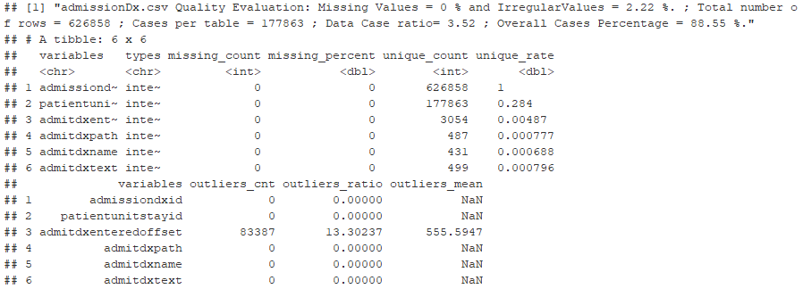
Examples
Table AdmissionDx: Good Data Quality
GROUP 1: DATA QUALITY
CRITICAL CARE DATATHON - TARRAGONA 2018

Slide 6
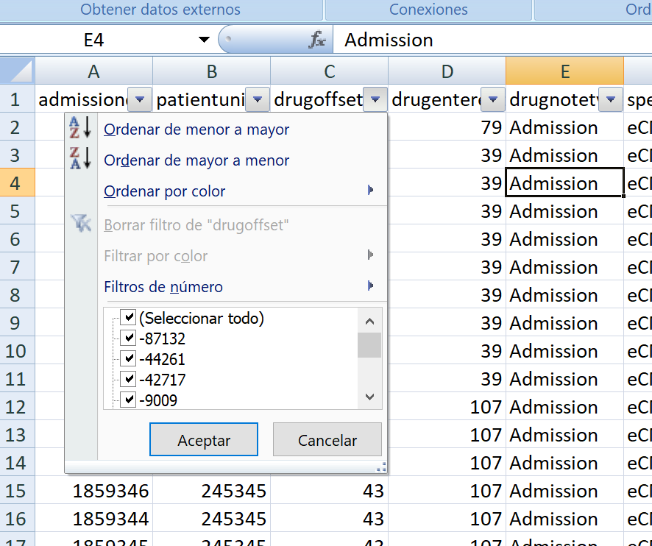
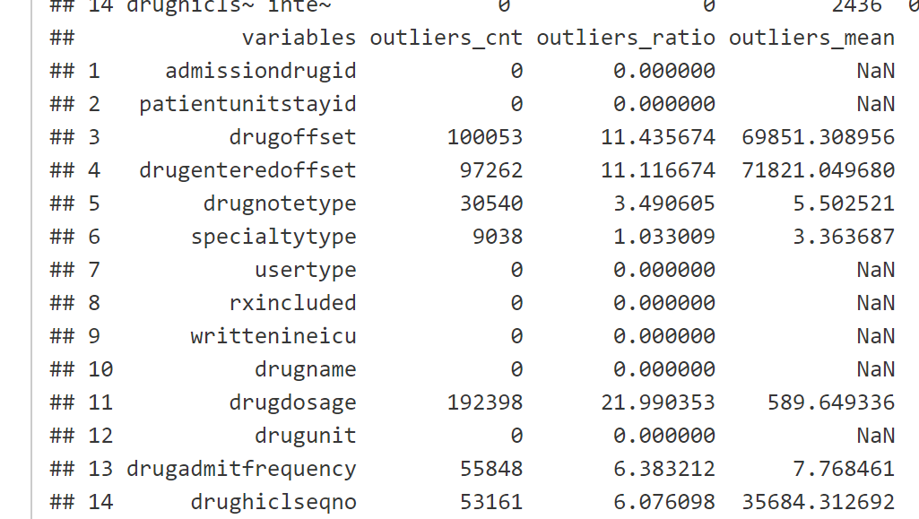
Examples
Table admissiondrug :Poor Data Quality
GROUP 1: DATA QUALITY
CRITICAL CARE DATATHON - TARRAGONA 2018

Slide 7
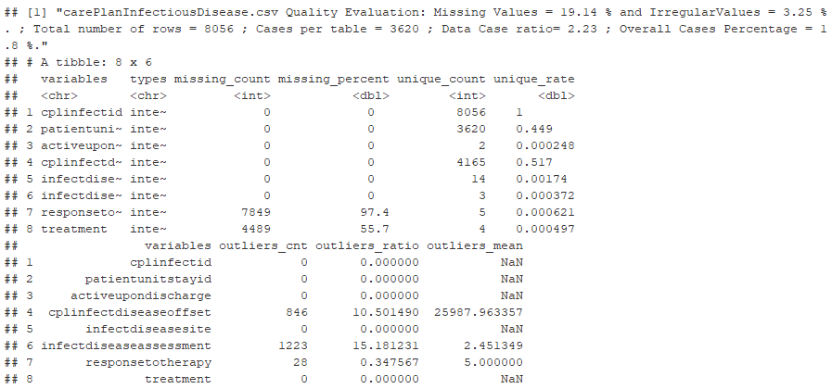
Examples
CarePlanInfectiousDisease Poor Data Quality
GROUP 1: DATA QUALITY
CRITICAL CARE DATATHON - TARRAGONA 2018

Slide 8
Conclusions
Descriptive Data Quality Assessment (ddQA)
proved to be a feasible approach to analyze eICU Data Quality.
It can be extended to other databases.
GROUP 1: DATA QUALITY
CRITICAL CARE DATATHON - TARRAGONA 2018

Slide 9


Future steps…
ICDI
International Critical Data Index
GROUP 1: DATA QUALITY
CRITICAL CARE DATATHON - TARRAGONA 2018

Slide 10

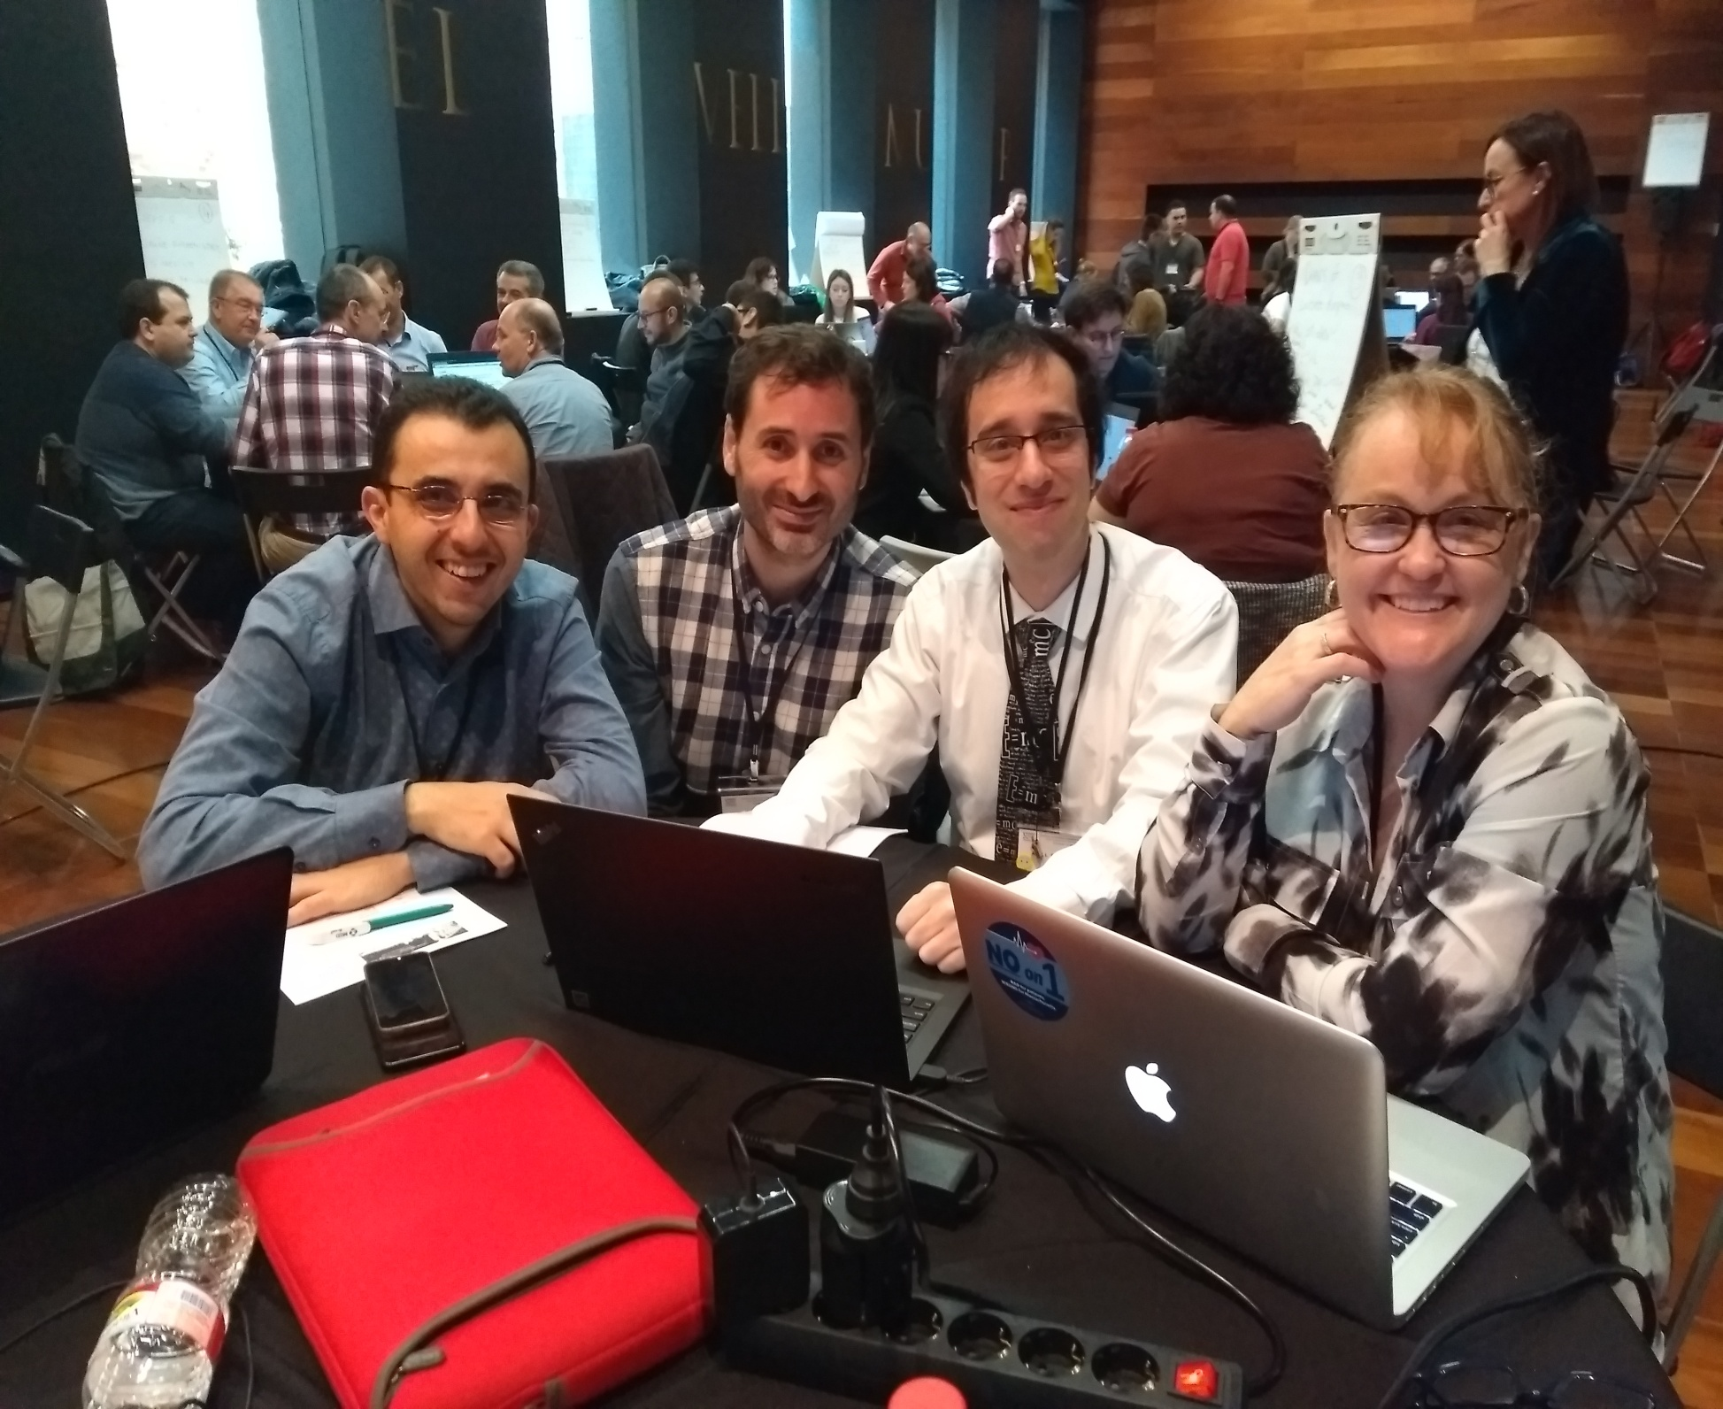
Thanks! – Gracias!
Juan Alfonso Soler , Murcia, ESP
jtrenado@mutuaterrassa.es
Ariel L. Fernández, BA, ARG hardineros@hardineros.com
Josep Trenado , Terrassa, ESP jtrenado@mutuaterrassa.es
Teresa Rincon, Boston, USA
tarincon1@gmail.com
GROUP 1: DATA QUALITY
CRITICAL CARE DATATHON - TARRAGONA 2018

Slide 11
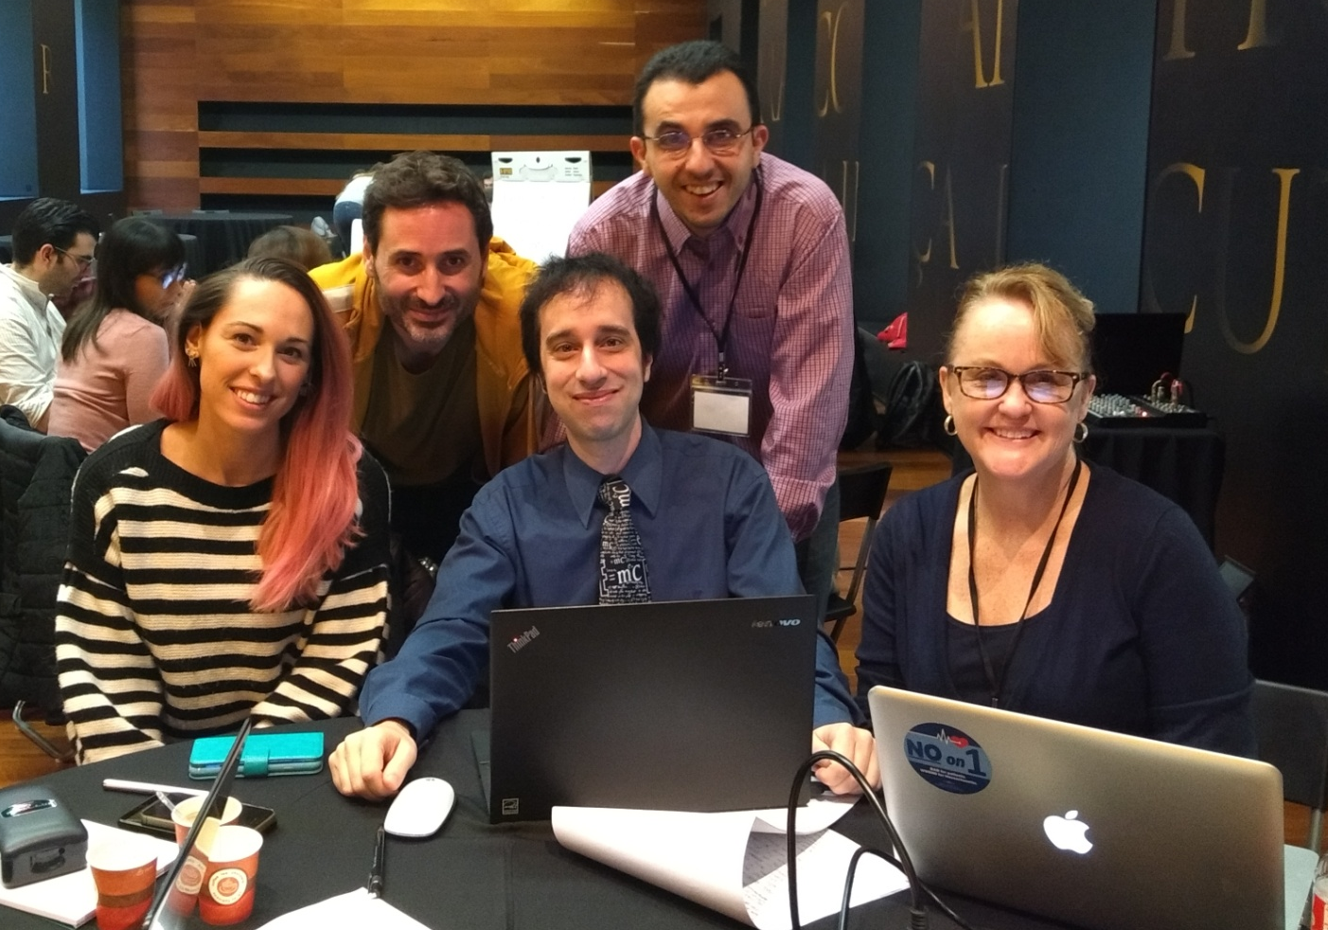
And just in case… we already have a lawyer ☺
GROUP 1: DATA QUALITY
CRITICAL CARE DATATHON - TARRAGONA 2018

